Slide 1
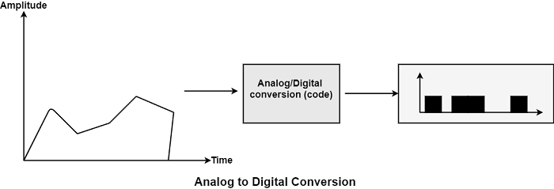
Lec -12
PHYSICAL LAYER: Modulation & Multiplexing
Analog to Digital Conversion .

Slide 2
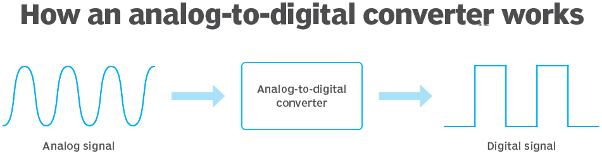
What is analog to digital conversion ?
It is a type of method in which analog signal is digitalized, that is known as analog-to-digital conversion.
Analog-to-digital conversion (ADC) is an type of electronic process in which a continuously variable, or analog, signal is converted into a multilevel digital signal without altering its essential content.

Slide 3
Comparison between Analog and digital signals

Slide 4
Data is defined.
Data can be analog or digital. The term analog data refers to information that is continuous; digital data refers to information that has discrete states. Analog data take on continuous values. Digital data take on discrete values.
Signals can be analog or digital. Analog signals can have an infinite number of values in a range; digital signals can have only a limited number of values.

Slide 5
The forms of analog and Digital signal Periodic and Non Periodic Signal.
A periodic signal is a type signal which completes a pattern within a measurable time frame, called a period, and repeats that pattern over subsequent identical periods.
The completion of one full pattern is called a cycle .
A non-periodic signal changes without exhibiting a pattern or cycle that repeats over time.
Both analog and digital signals can be periodic or non-periodic.
In data communications, we commonly use periodic analog signals and nonperiodic digital signals.

Slide 6
analog to digital conversion example.
Some important Examples of analog and digital conversion is sine waves, the waveforms representing human speech and the signals from a conventional television camera. The output of the analog-to-digital converter has defined levels or states.

Slide 7
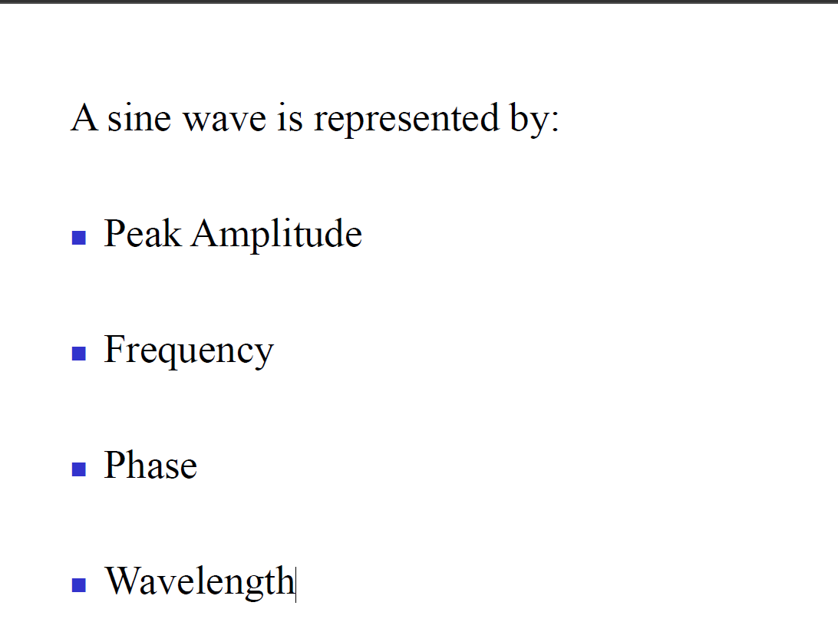
Sine wave.

Slide 8
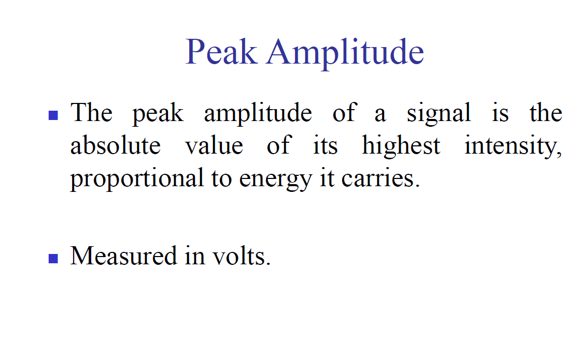

Slide 9
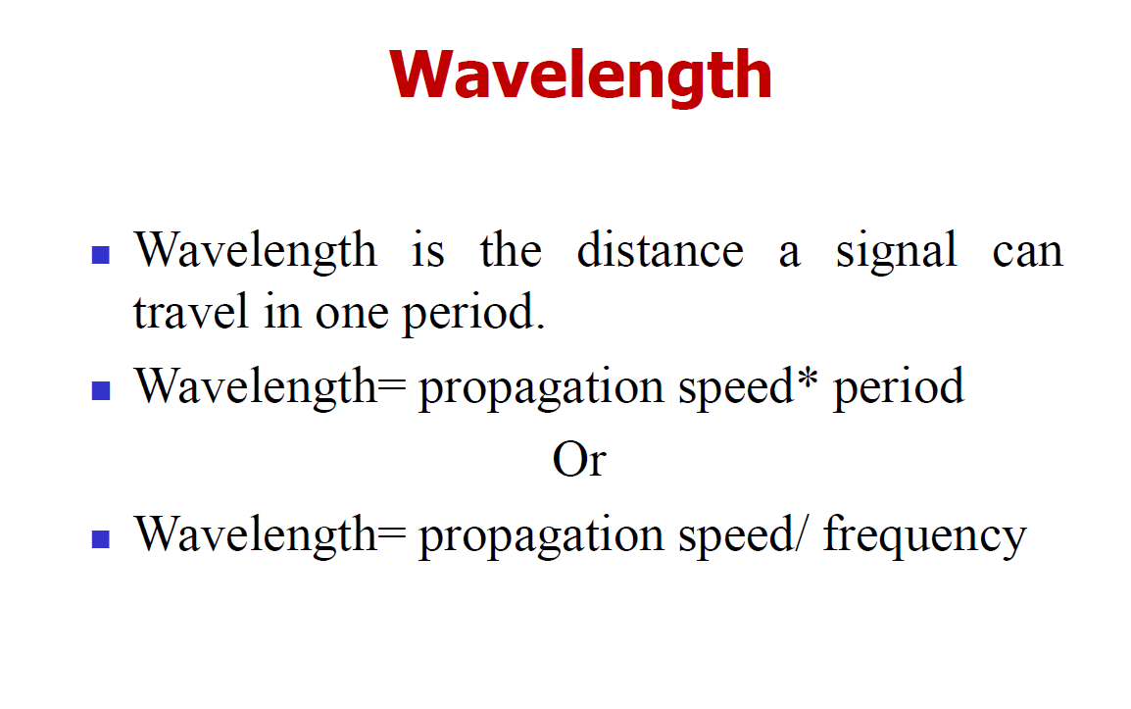
Wave length .

Slide 10
Two signals with the same phase and frequency, but different amplitudes

Slide 11
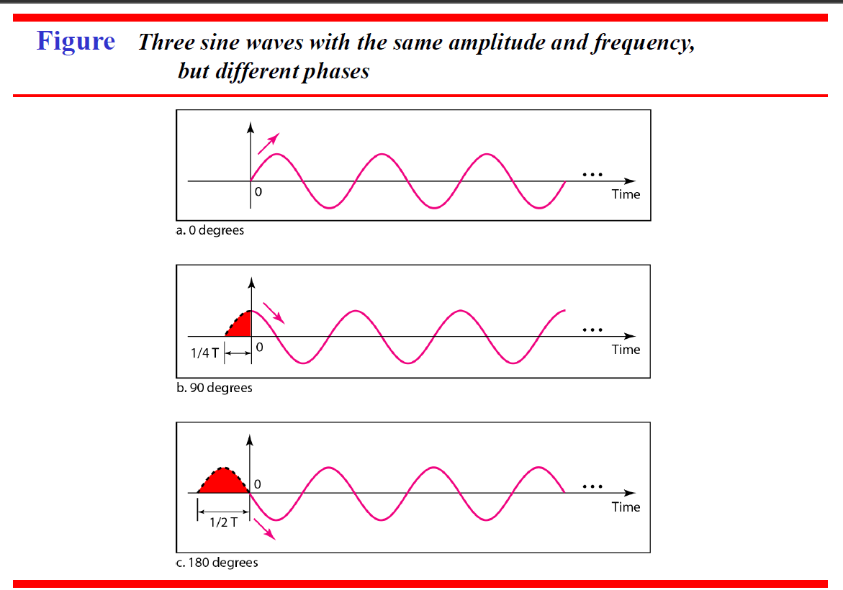
Same amplitude and frequency but different phases.

Slide 12
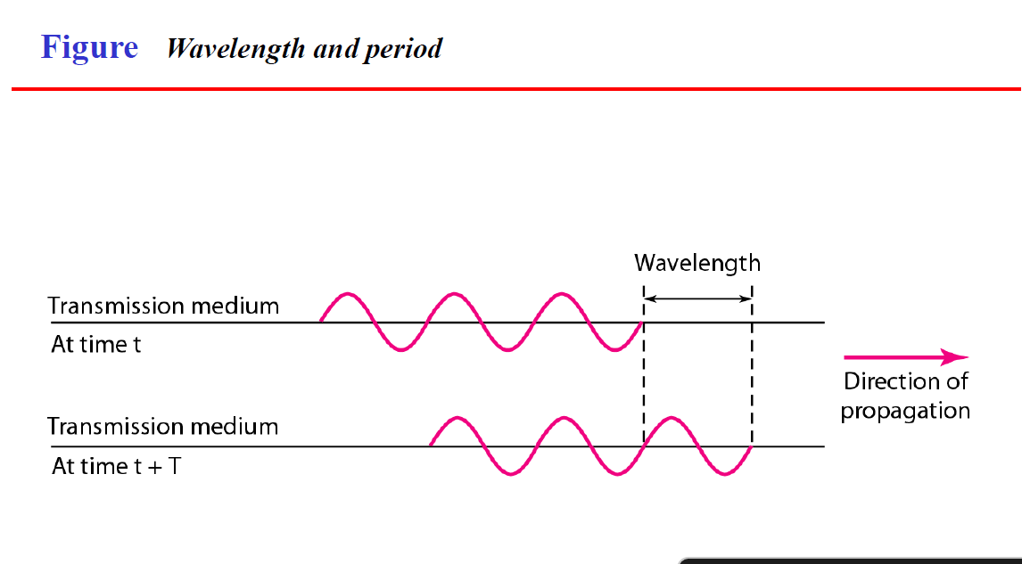
Wavelength and period.

Slide 13
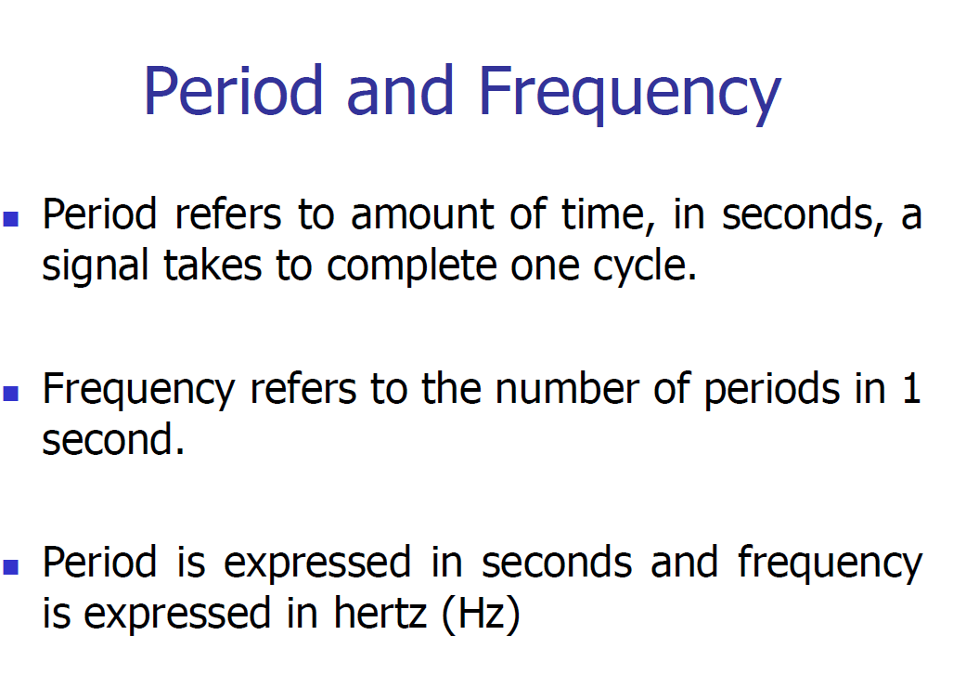
What is period and frequency?

Slide 14
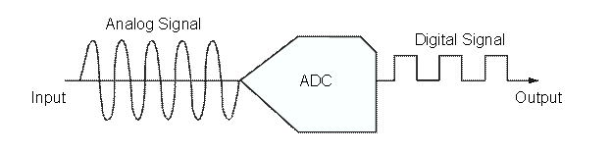
Importance AND Example of analog- to-digital conversion
Analog-to-Digital converters (ADC) translate analog signals, real world signals like temperature, pressure, voltage, current, distance, or light intensity, into a digital representation of that signal. This digital representation can then be processed, manipulated, computed, transmitted or stored.

Slide 15
Types of Analog to Digital Converter.
Successive Approximation ADC: This converter compares the input signal with the output of an internal DAC at each successive step. It is the most expensive type.
Dual Slope ADC: It have high accuracy but very slow in operation.
Pipeline ADC: It is same as that of two step Flash ADC.
Delta-Sigma ADC: It has high resolution but slow due to over sampling.
Flash ADC: It is the fastest ADC but very expensive.
Other: Staircase ramp, Voltage-to-Frequency, Switched capacitor, tracking, Charge balancing, and resolver.

Slide 16
Application of ADC .
Used in computer to convert the analog signal to digital signal.
Used in cell phones.
Used in microcontrollers.
Used in digital signal processing.
Used in scientific instruments.
Used in music reproduction technology etc.

Slide 17


